Slide 1
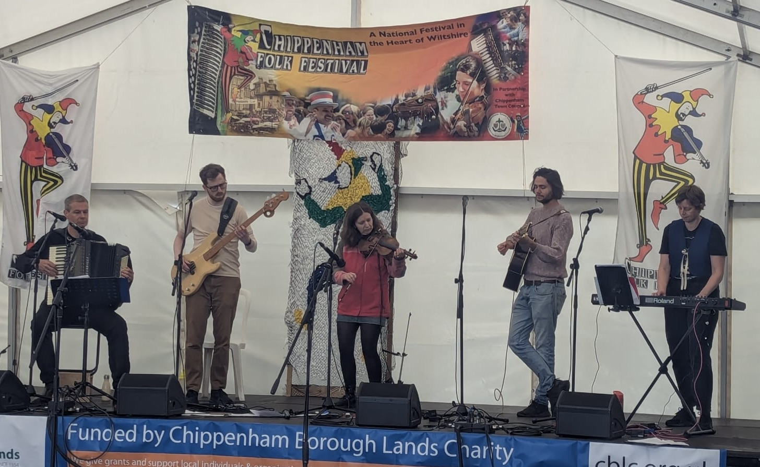
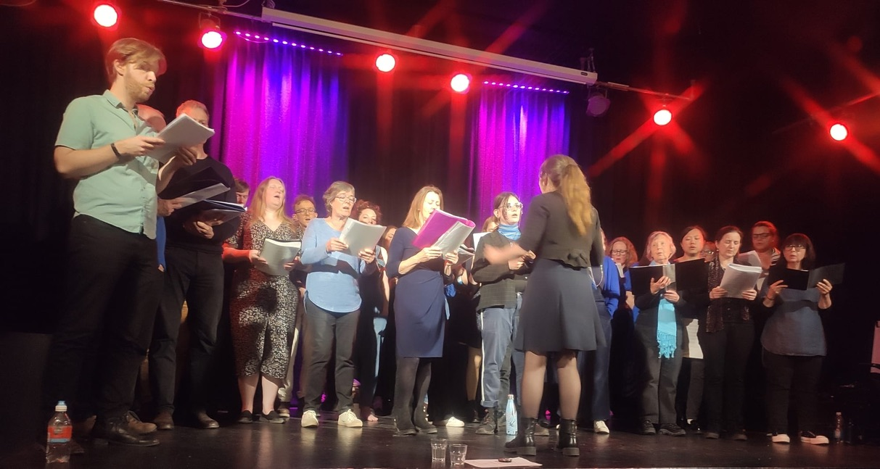
Bristol Folk House Choir
Summer Ceilidh & Concert
Ceilidh Band:
Magician’s Nephew
Caller:
Miriam Ayling
Tuesday 15th July
Doors open at 7.00pm
Ceilidh starts at 7.30pm
Tickets £5
Bristol Folk House
40a Park Street, BS1 5JG
www.bristolfolkhouse.co.uk/choir
0117 926 2987

